Slide 1
CS 129.1 A: Project Defense
Cafe, Chua, Gamboa, Guian

Slide 2
Big Data Problem
Given the family income and expenditure data of the Philippines, what are the spending behaviors of different socioeconomic classes and what are the implications of these spending behavior? Results will be shown in different charts.

Slide 3
Data Sources
Kaggle: Philippine Family Income and Expenditure (.csv file with 41,554 entries)
Total Monthly Income
Location/Region
Total Food Expenditure
Total Income and its Source
Food Expenditure Breakdown (Bread, Rice, Meat, Fish, Vegetables, etc.)
Other Expenditures (Alcohol, Medical, Education, Communication, Clothing, etc.)
Household Information (Family Head, Age, Number, Occupation, Facilities, etc.)

Slide 4
Data Sources
Rappler: Income Class and Range of Monthly Income (Family Size of 5)
Poor | Less than PHP7,890 per month
Low | PHP 7,890 to 15,780
Low Middle | PHP 15,780 to 31,560
Middle | PHP 31,560 to 78,900
Upper Middle | PHP 78,900 to 118,350
Upper | PHP 118,350 to 157,800
Rich | At least PHP 157,800

Slide 5
Key Results
Despite the love of Filipinos for rice, Bread is often the number 1 food type that Filipinos spend on. The budget for bread is decreasing as the socioeconomic class gets higher, but budget for meat increases.
As for Miscellaneous Expenditures, most Filipinos regardless of socioeconomic class spend most of their budget to Housing, followed by Transportation.
There is little to no correlation (score <0.10) between a certain Food Type vs Medical expenditures. Exception: Among the rich, there is a correlation score of 0.32 between Fruits and Medical expenditures.

Slide 6
Implications of the Results
The lower the income, the higher the percentages for cheap necessities. And as the income gets higher, there is more budget allocated to luxuries such as clothes and higher costing food types such as meat or even dining in a restaurant.
Even with a higher income, budgets on specific food types and other expenditures do not vary often.
There are very few patterns that can be seen in using Pearson’s Correlation Score with income versus food & miscellaneous expenditures.

Slide 7
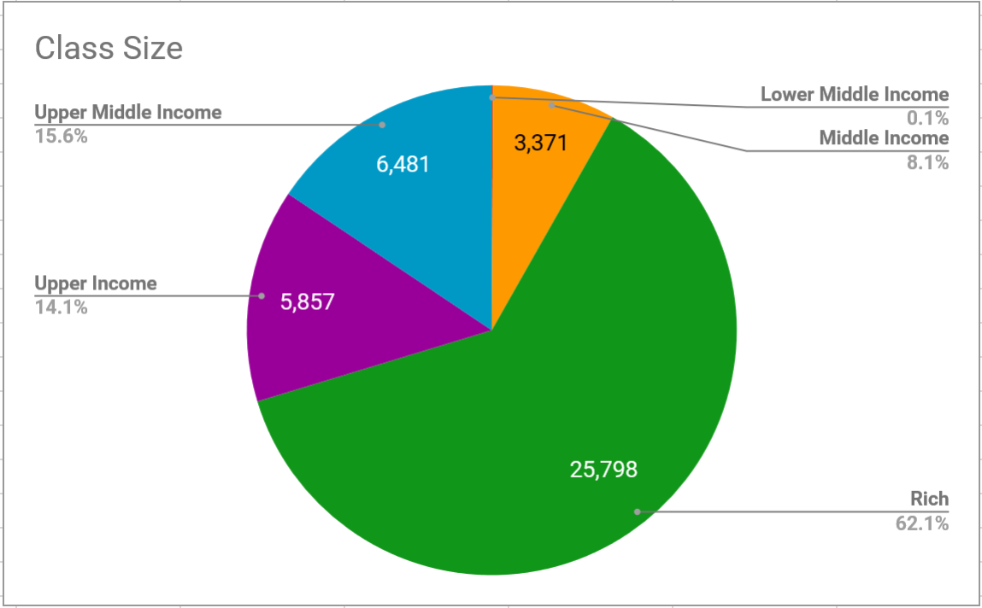
Output 1
Sorting and counting families by socioeconomic class

Slide 8
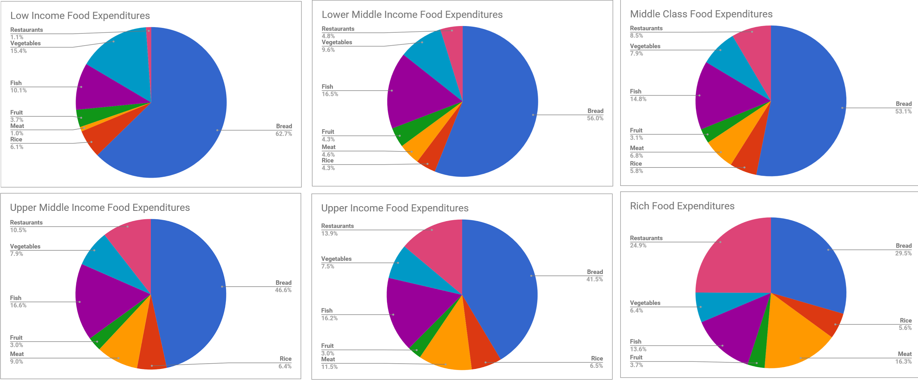
Output 2
Average expenditure of each food type per socioeconomic class

Slide 9
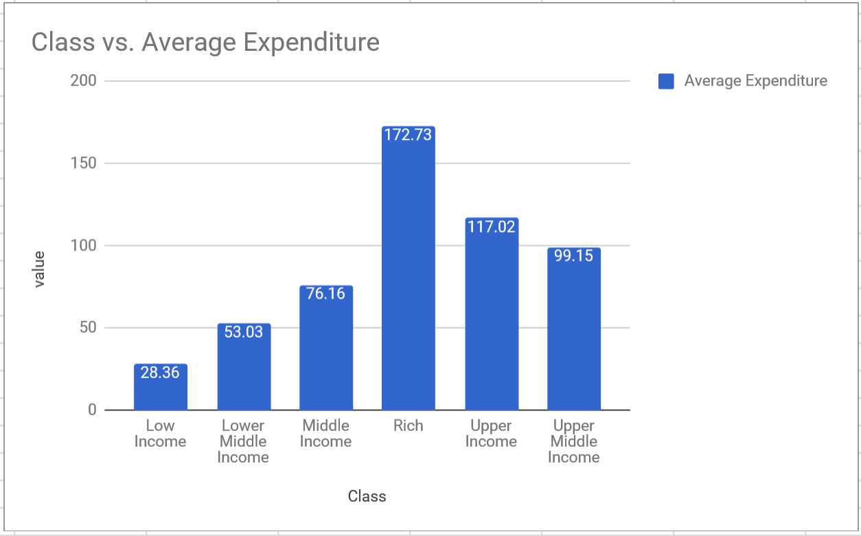
Output 3
Average meal cost per socioeconomic class

Slide 10
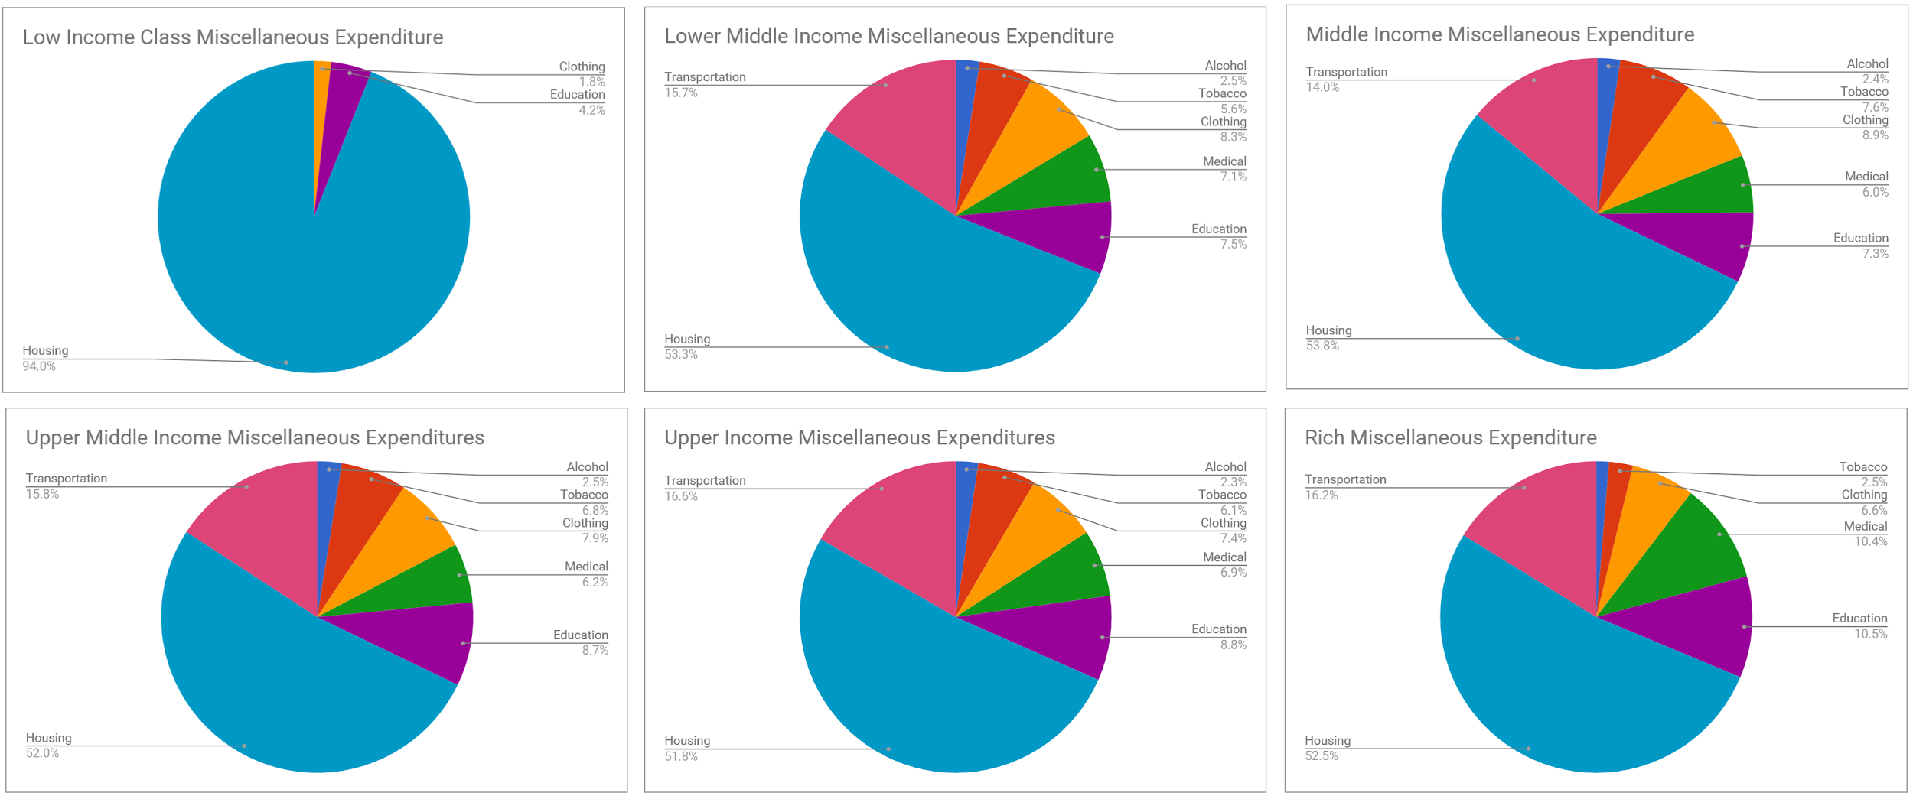
Output 4
Average miscellaneous expenditure per socioeconomic class

Slide 11
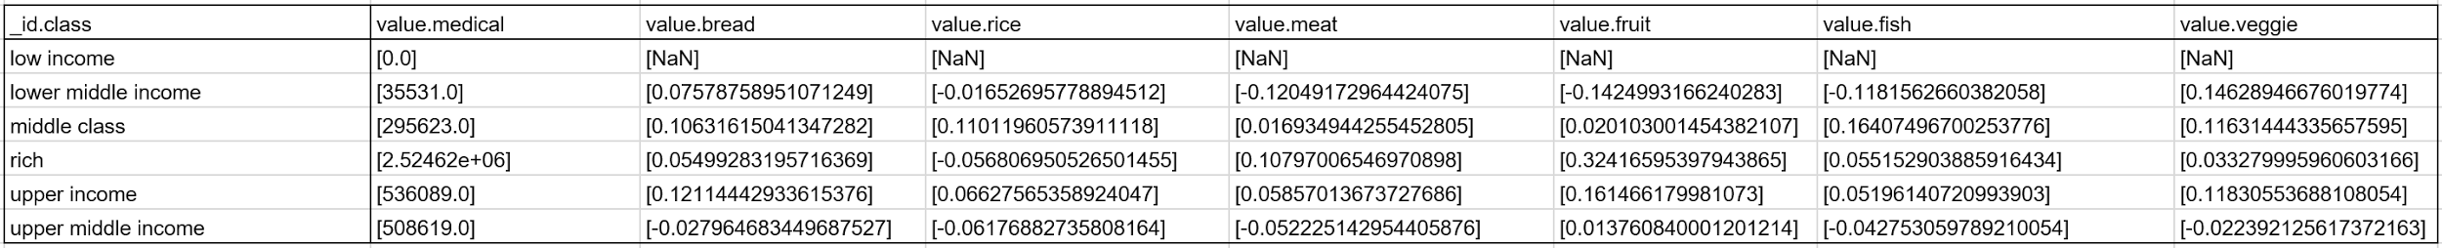
Output 5
Correlation of food types and medical expenses
There is weak to no correlation in all food types vs. medical expenditure in all socioeconomic classes except that there is a correlation between the fruit and medical expenditures of the class, “rich”.
Possible reason is that the “rich” can afford to consult with a doctor, and the doctor recommends them to spend on fruits in order to stay healthy.

Slide 12
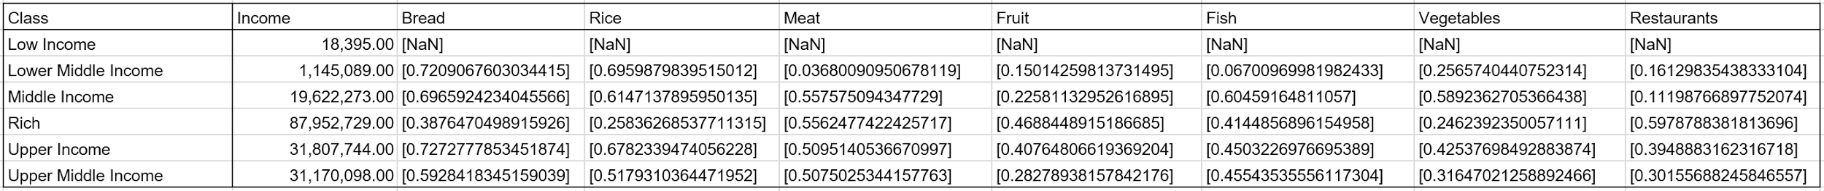
Output 6
Correlation of Income and Food
No specific pattern of correlation

Slide 13
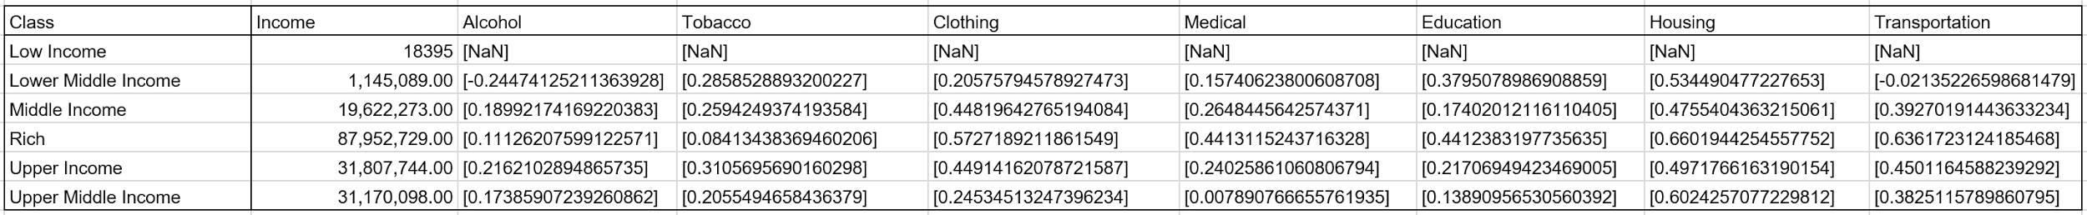
Output 7
Correlation of Income and Miscellaneous Expenditures
There is a huge variation between the correlations in this output. Noticeable patterns are the strong correlation between income and housing expenditures for all socioeconomic classes, and the strong correlation of income and clothing for Middle, Upper and Rich classes.

Slide 14
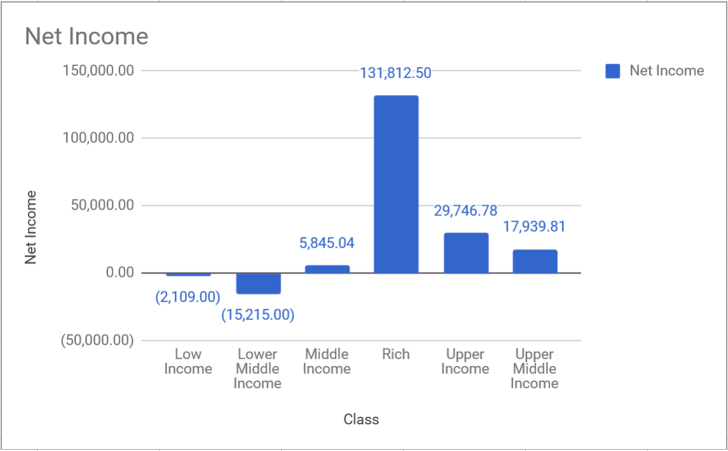
Output 8
Total excess/deficit per socioeconomic class

Slide 15
Demonstration

